Slide 1

Time Management & Work-Life Balance: From Campus to Corporate
Hello everyone! Today, we'll explore two critical skills for success: time management and work-life balance. These concepts are vital not just for academic life but are indispensable in the corporate world. Let's learn how to optimize our time and harmonize our professional and personal lives.

Slide 2
What is Time Management?
Strategic Planning
Enhanced Productivity
Intelligent Resource Allocation
Time management is the conscious process of planning and organizing how much time to dedicate to specific activities. It's about making deliberate choices to maximize efficiency.
Effective time management is the cornerstone of increased productivity. It ensures you're working smarter, not just harder, focusing on tasks that yield the most impact.
It means not squandering precious time and instead channeling your efforts towards what truly matters. It’s about being strategic with your most valuable resource: your time.

Slide 3
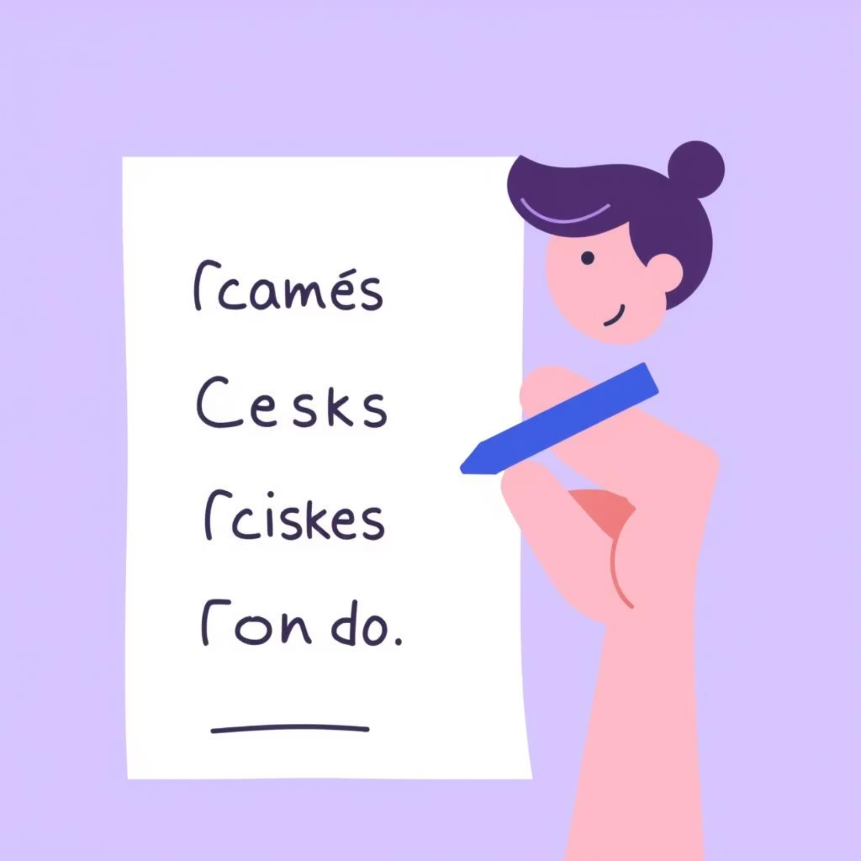
Why Time Management is Important
Helps you complete tasks on time, eliminating last-minute stress.
Boosts productivity, whether in academic pursuits or professional roles.
Significantly reduces mental pressure and anxiety, fostering a calmer mind.
Allocates more time for rest, personal interests, and family, enriching overall life quality.
In essence, mastering time management cultivates a more balanced, less stressful, and ultimately more fulfilling life.

Slide 4





Tips for Better Time Management
Prioritize with a To-Do List
Begin each day by creating a comprehensive to-do list, detailing all tasks to be accomplished. This provides a clear roadmap for your day.
Utilize Organizational Tools
Employ a planner or digital calendar to schedule and organize your commitments. Visualizing your schedule helps in allocation.
Deconstruct Large Tasks
Break down intimidating projects into smaller, manageable segments. This approach makes tasks less overwhelming and more achievable.
Minimize Distractions
Actively avoid common distractions like mobile phones and non-essential conversations during focused work periods.
Incorporate Short Breaks
Regular, brief breaks refresh your mind and enhance focus, preventing burnout and maintaining peak performance throughout the day.

Slide 5
What is Work-Life Balance?
Work-life balance is the harmonious integration of your professional responsibilities with your personal life. It’s about ensuring that your job doesn't eclipse other crucial aspects of your existence.
Professional Dedication
Personal Fulfillment
While commitment to your career is important, it shouldn't consume your entire identity. It encompasses your working hours, tasks, and career aspirations.
This includes time for self-care, family, friends, hobbies, and personal growth. It's about nurturing the aspects of life that bring you joy and contentment.
Achieving a healthy balance means you're neither constantly overworked nor perpetually exhausted, leading to sustained well-being.

Slide 6



Why Work-Life Balance Matters
Enhanced Well-being
Stronger Relationships
Increased Productivity
A balanced life directly correlates with reduced stress and heightened feelings of relaxation, significantly improving your mental and physical health.
It provides invaluable time for nurturing relationships with family and friends, alongside opportunities for personal development and pursuing passions.
Paradoxically, prioritizing personal time makes you more focused and efficient when you are at work, leading to better professional outcomes.
Neglecting this balance can lead to burnout and dissatisfaction, even in a successful career. Prioritizing it ensures sustained happiness and effectiveness.

Slide 7
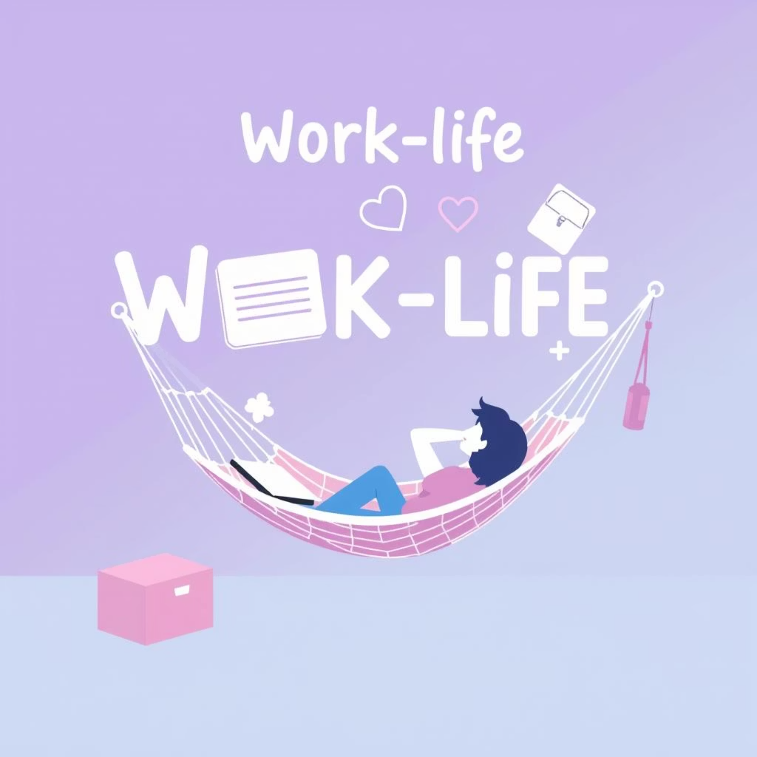
How to Maintain Work-Life Balance
Establish Clear Boundaries
Consciously separate professional duties from personal time. Avoid the temptation to blend the two, especially after working hours.
Disengage from Work Communications
Resist the urge to check emails or perform office tasks once your workday concludes. Dedicate this time to non-work pursuits.
Invest in Personal Connections
Actively dedicate time to loved ones and engage in hobbies that bring you joy and relaxation.
Prioritize Self-Care
Attend to your physical and mental well-being through exercise, healthy eating, and mindfulness practices.
Ensure Adequate Rest
Prioritize sufficient sleep and permit yourself necessary breaks to recharge your energy and focus.

Slide 8
Final Thoughts
In conclusion, both time management and work-life balance are not merely beneficial but are essential cornerstones for a successful and happy life. Mastering these skills empowers you to navigate challenges with greater ease and confidence.
Enhanced Focus
1
Better time allocation leads to increased concentration and efficiency in all tasks.
Reduced Stress
2
Proactive planning and clear boundaries alleviate pressure and promote tranquility.
Increased Satisfaction
3
A balanced life fosters greater contentment and fulfillment in both personal and professional spheres.
By embracing these principles, you gain control over your time and cultivate a harmonious existence that fosters peace, professional triumph, and personal happiness.
Thank you!

Slide 9

Questions?
Feel free to ask any questions you have regarding time management or work-life balance.

